Slide 1


Slide 2


Slide 3
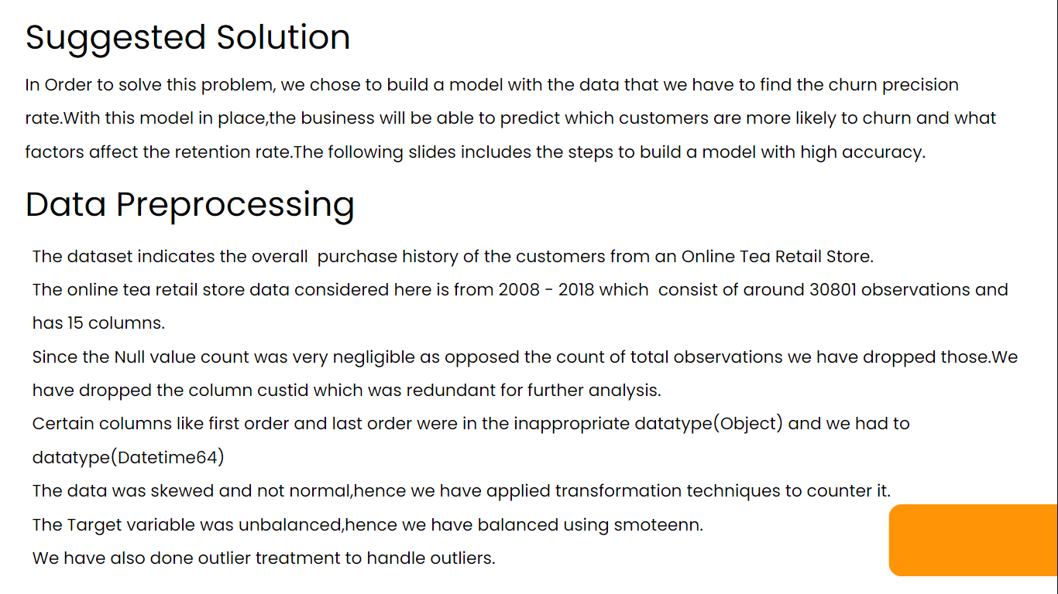

Slide 4

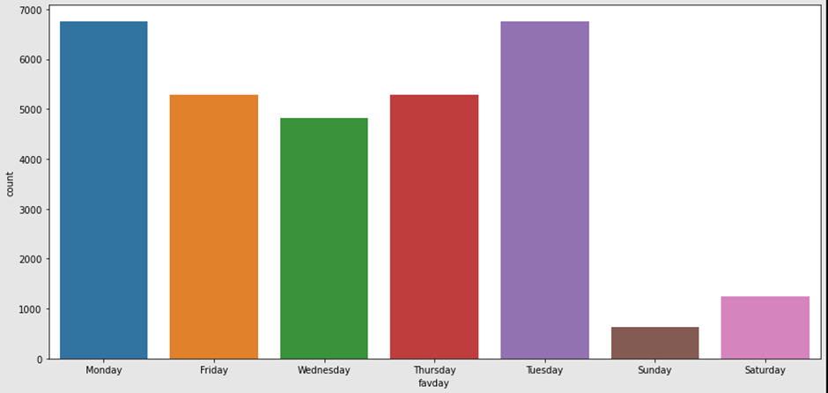
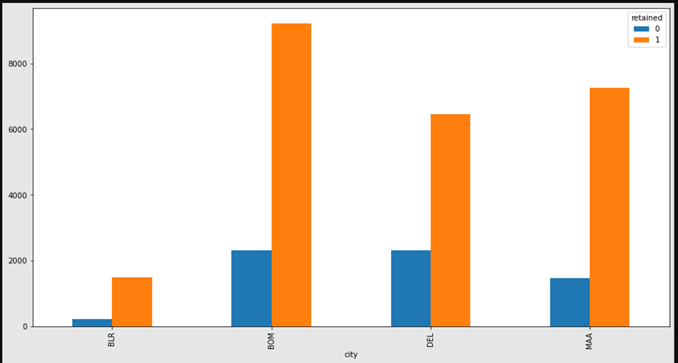
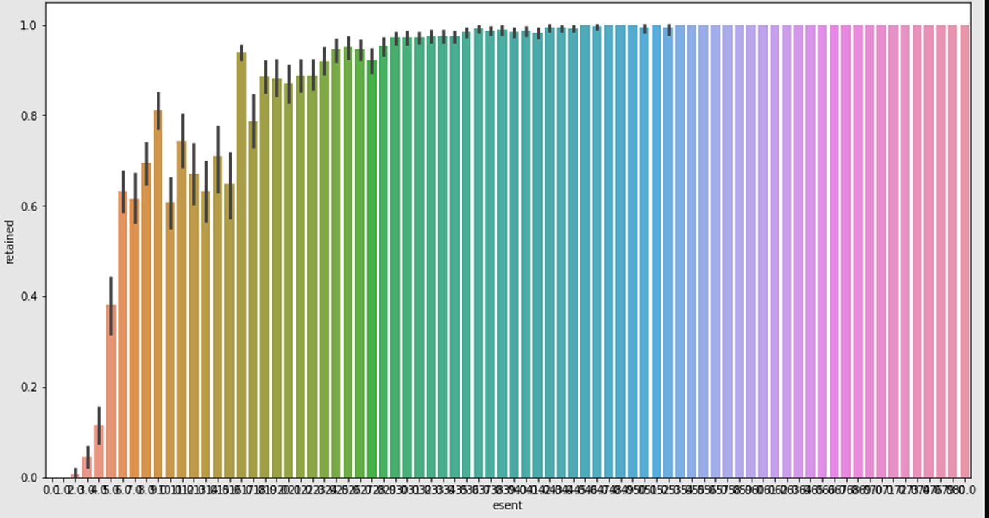
Exploratory Data Analysis
The number of orders delivered are highest on Monday and Tuesday since the number of orders placed are maximum on Saturday and Sunday.
The retention rate is maximum in Bombay because of high population and rainy climatic conditions.
Bangalore has the least retention rate because people in Bangalore prefer coffee over tea.
As esent increases customers are likely to be retained

Slide 5
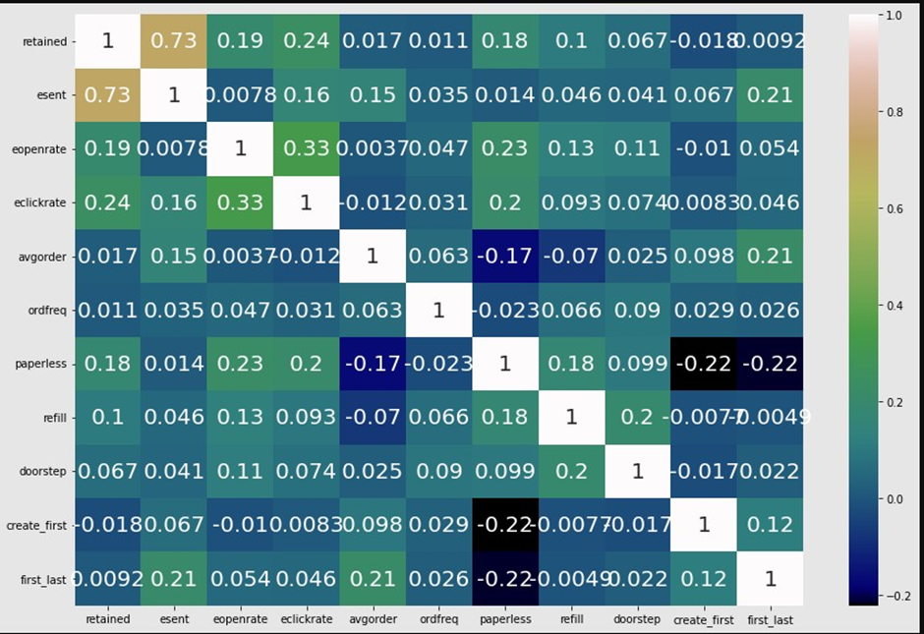
Inferences -
Positive correlation for esent and retained
Positive correlation(moderate) for esent and eopenrate
Paperless and Avg order are negatively correlated

Slide 6
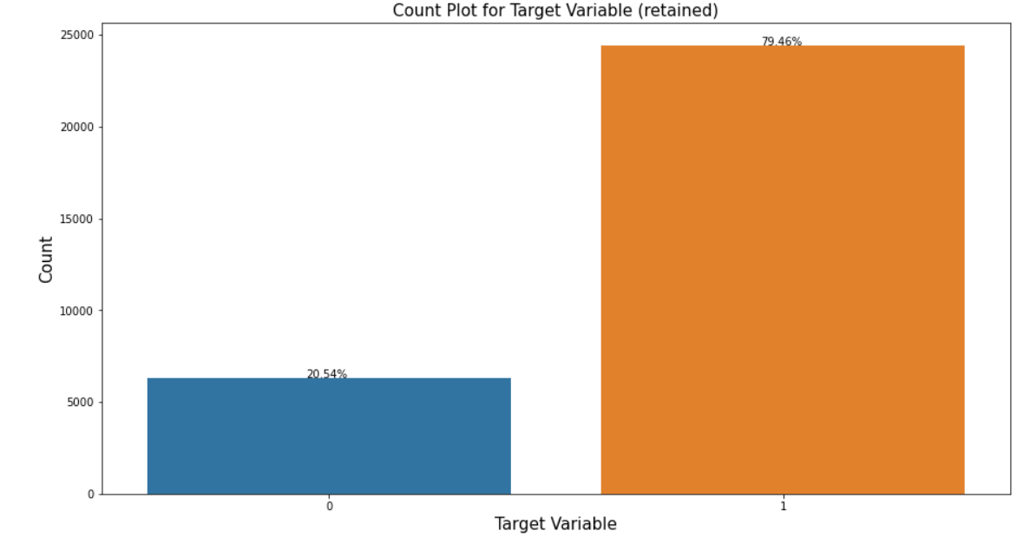
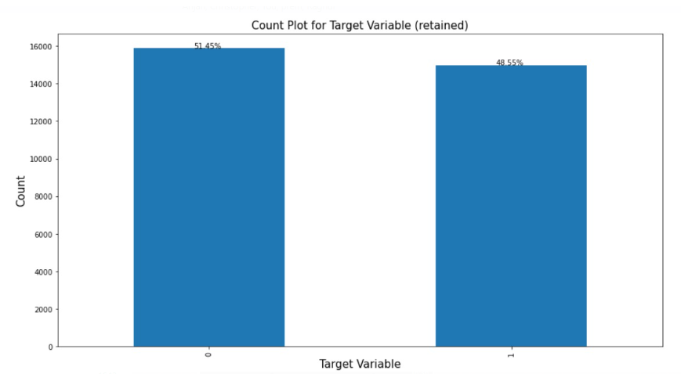
We can infer that the data is imbalanced. To treat it we can use Imbalanced classification involves developing predictive models.
After treating the imbalanced data now the target variable is balanced.
Challenges faced - Conversion of a few datatypes,scaling the data & Model building.

Slide 7
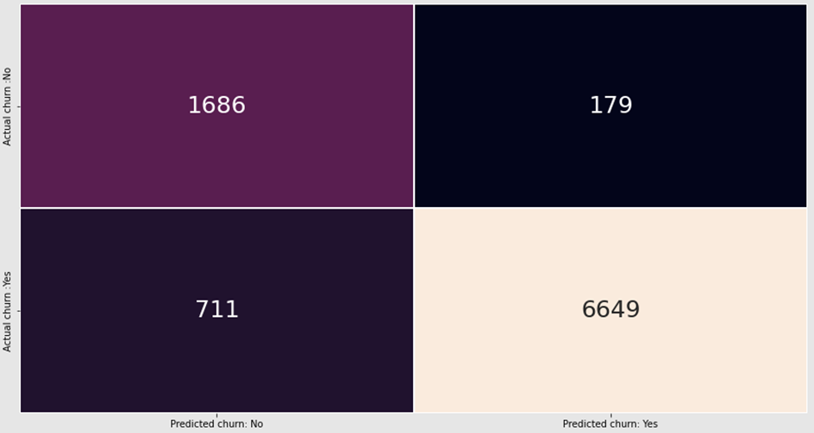
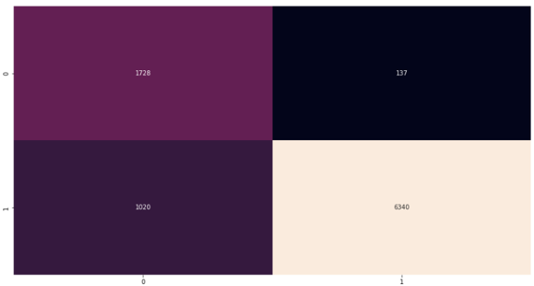
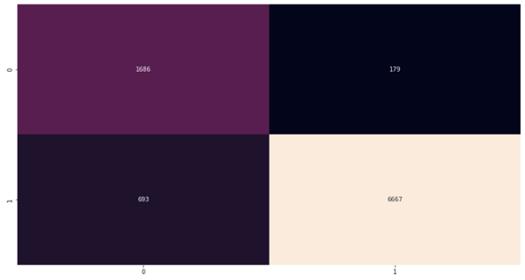
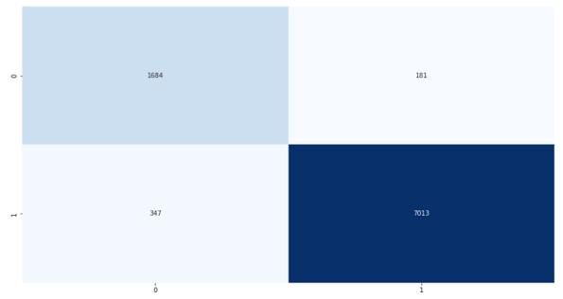
Algorithms considered
Base Model
RFE model
RFE model
Base model
Decision Tree model
Random Forest model

Slide 8
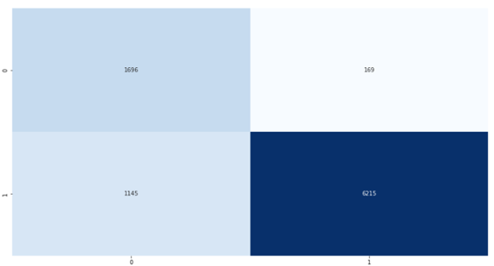
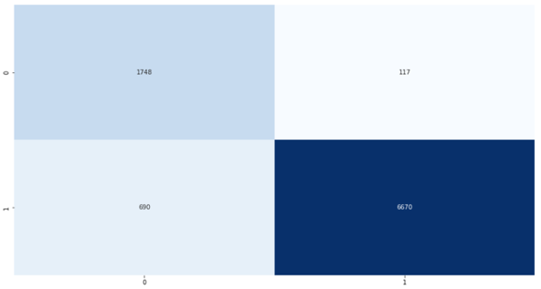
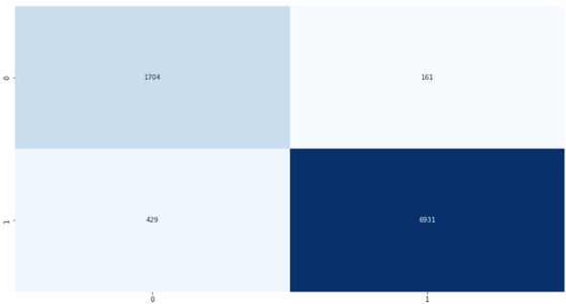
We have used 7 Machine learning algorithms to find out the accuracy and ROC-AUC score with respect to this data.
Ada boost
XG boost
Stacking

Slide 9
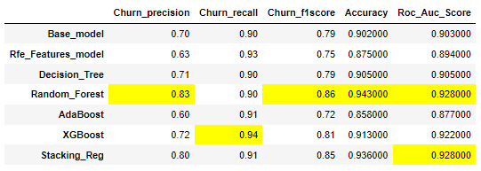
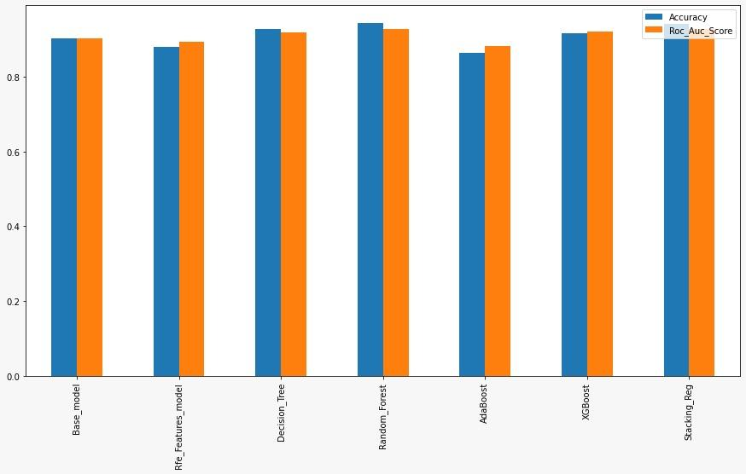
Results
Based on the results it is evident that our dataset performs better with the Random_Forest Model.
The accuracy of the Random_Forest model is comparitively better than other models.Accuracy of Random Forest Model - 94.3% and ROC-AUC score is 92.8% which is better than most of the other models.
Features affecting our target variable - esent,favday_Sunday,favday_Saturday,city_DEL,create_first,doorstep,first_last,ordfreq,refill

Slide 10
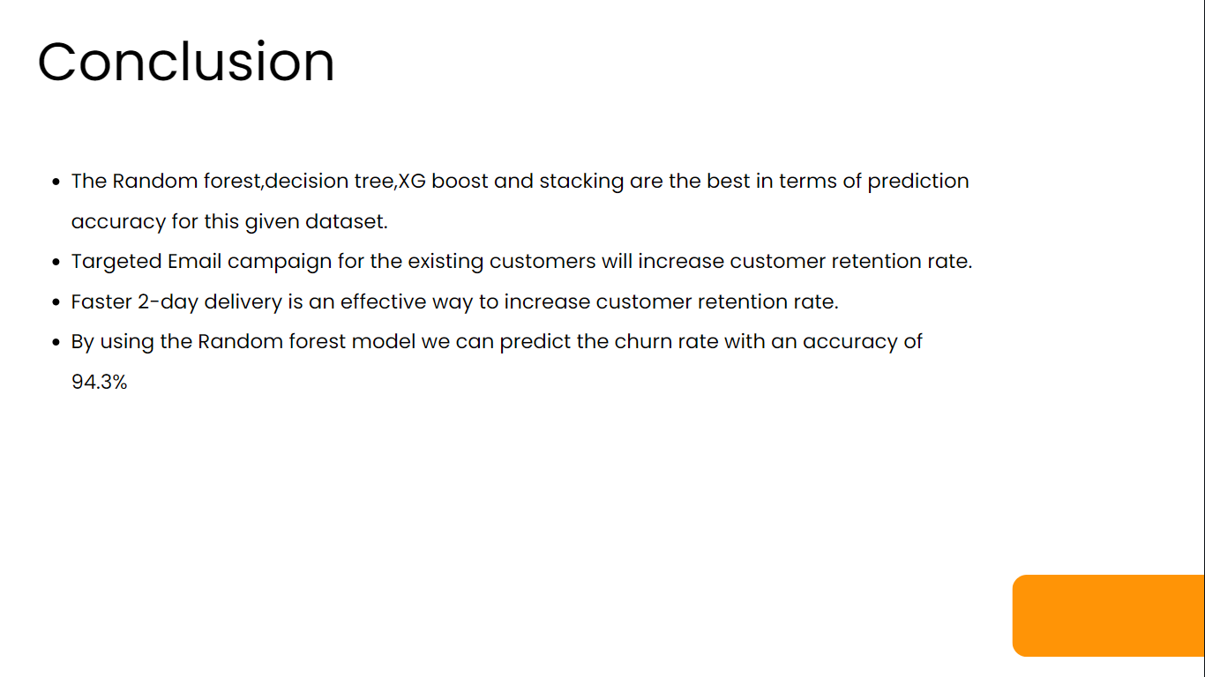

Slide 11


Slide 12


